Slide 1
ML Interim Project Presentation
Automated Financial Distress Predictor
Group No. - 25
Ashwin Sheoran: 2020288
Harsh Goyal: 2020562
Shivam Jindal: 2020125
Sourav Goyal: 2020341

Slide 2
Motivation
Banks play a crucial role in market economies. They decide who can get finance and on what terms and can make or break investment decisions. For markets and society to function, individuals and companies need access to credit.
Credit scoring algorithms, which guess the probability of default, are the methods banks use to determine whether or not a loan should be granted. This model helps to improve the state of the art in credit scoring by predicting that someone will experience financial distress in the next two years.

Slide 3
Literature review
1. Automated Credit Scoring System for Financial Services in Developing Countries [1] by Rebeka Sultana, Samira Muntaha, Farhana Sarker, D. M. Anisuzzaman, Khondaker A. Mamun suggests using Linear regression over decision trees and KNN, The only problem with Linear Regression was that the quality of model decreased when a small dataset was used. For KNN, predictive accuracy was extremely affected by the measure of distance and the cardinality of the neighbourhood. DT could not predict correctly when a smaller dataset was used.

Slide 4
2. Financial Distress Prediction based on Multi-Layer Perceptron with Parameter Optimization [2] by Magdi El Bannany, Ahmed M. Khedr, Meenu Sreedharan and Sakeena Kanakkayil, Although this paper suggests we use Neural Networks, apart from it on comparing the bias and variance of different models we can see that Random Forests are best suited for this.

Slide 5
Dataset Description
We took our dataset from Kaggle[3]; we have the data of 251503 people, which was divided into training, test and validation dataset.
Feature | Data Type
RevolvingUtilizationOfUnsecuredLines | float
age | int
NumberOfTime30-59DaysPastDueNotWorse | int
DebtRatio | float
MonthlyIncome | int
NumberOfOpenCreditLinesAndLoans | int
NumberOfTimes90DaysLate | int
NumberRealEstateLoansOrLines | int
NumberOfTime60-89DaysPastDueNotWorse | int
NumberOfDependents | int

Slide 6
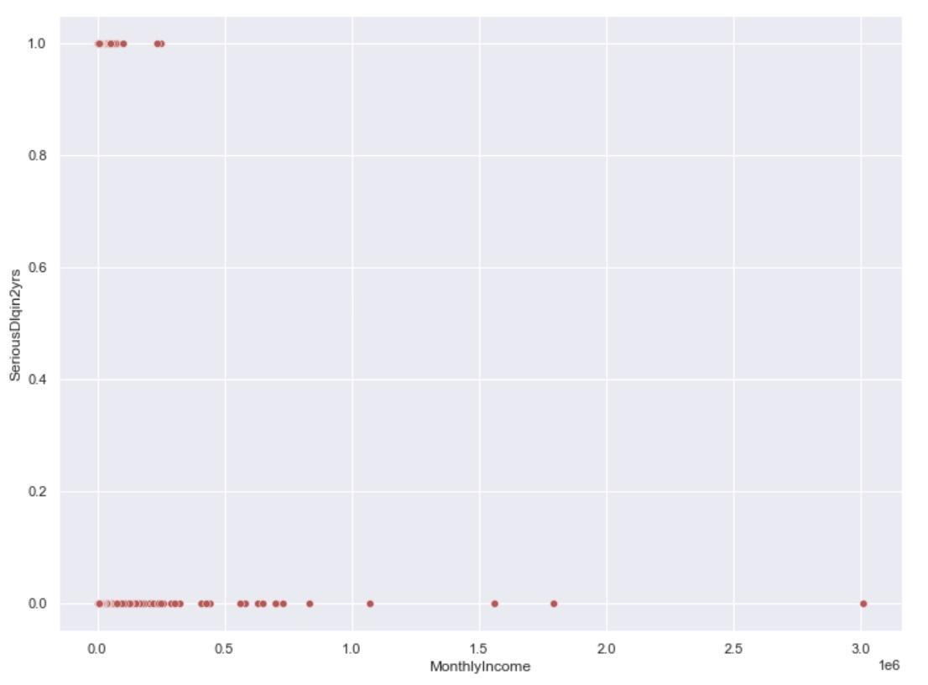
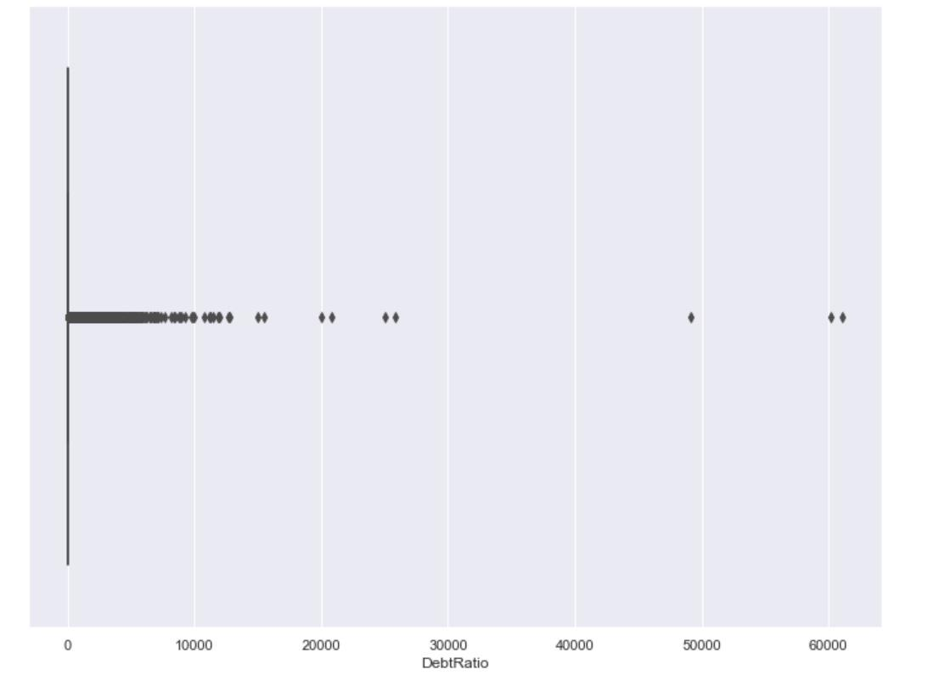
EDA
This is a scatterplot graph between Serious Deliquency Rate in 2 years and Monthly Income before we did Standardization. Here we can easily see that People with More Monthly income will face less Delinquency in paying back loans.
Here we can see that before Standardization the Debt ratios greater than 1 are outliers in the data.

Slide 7
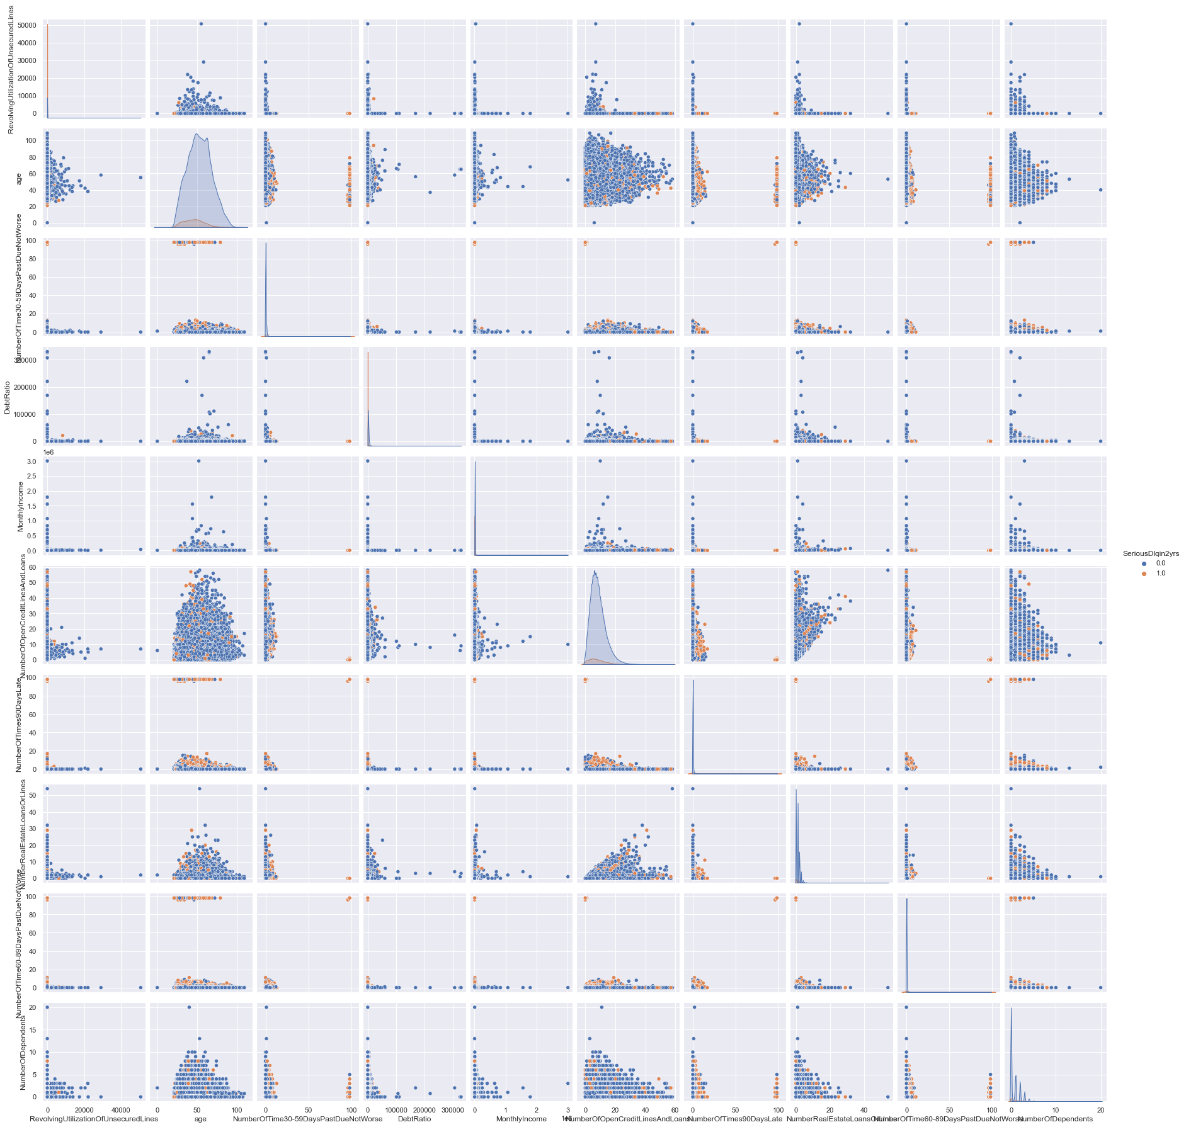
EDA
This is the pairplot between all the features.
https://drive.google.com/file/d/138i6aK8AK2pGAnmJhNOYMg0gw9UP5zVk/view?usp=sharing

Slide 8
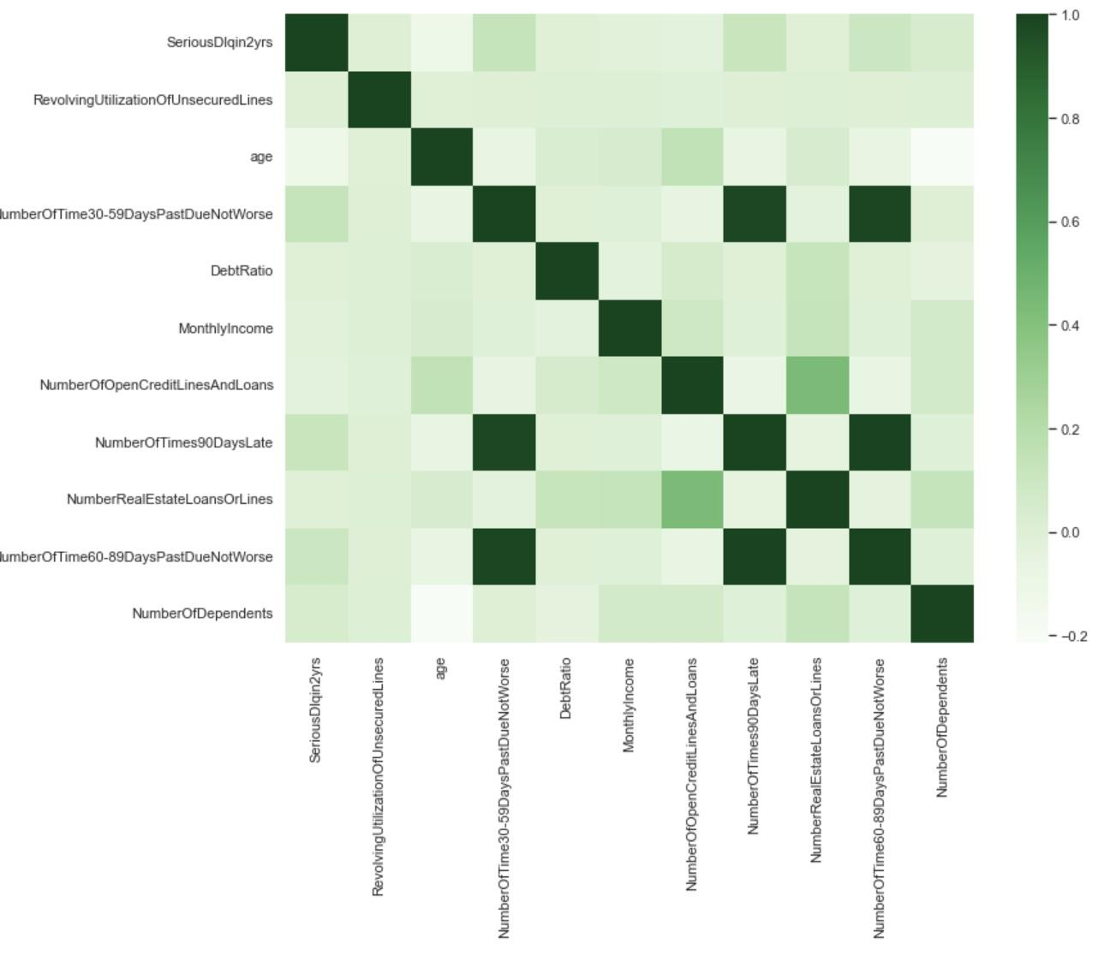
EDA
This is the heat map between the features

Slide 9
Preprocessing
Handling missing Values using SimpleImputer
We counted the NaN values in the dataset and replaced the Na Values by the mean along each column using SimpleImputer. SimpleImputer takes the mean of the column and replaces the missing values with the mean
Data Standardization
Standardization is a scaling technique where values are centered around mean with a unity standard deviation. This means that the mean of the attribute becomes zero and the resultant distribution has unit standard deviation. The formula used for standardization is z_{i} = ( x_{i} - x̄ ) /𝝈 . Here x̄ is the mean of the values , 𝝈 is the standard deviation of the values.

Slide 10
METHODOLOGY
Our objective is to classify whether the person fails to pay back his/her loan even after 90 days of the due date. We tried different ML-based classification algorithms for this binary classification problem, like Logistic Regression, Naive Bayes, Decision Trees, and Random Forests. We also tried different hyperparameter values in some of these classification algorithms to visualize the variations in the accuracy of the models with respect to these hyperparameters.
Decision Trees
We used non-scaled data for decision trees because decision trees are not sensitive to the variance of the data. Decision trees work as an if-else mechanism; hence, they are insensitive to the data points' values. We also visualized Decision Trees for different max depths and used both “entropy” and “gini” as our criterion.
Random Forests
We used non-scaled data for random forests because random forests are combinations of many weak decision trees (weak classifiers). Since decision trees are not sensitive to the data's variance, random forests are also not sensitive to the variance of the data. We also visualized Random Forests for different max depths with “gini” as the default criterion and 100 as the default n_estimators. We use the ensemble method to combine these weak decision trees using the maximum voting technique to make a random forest.

Slide 11
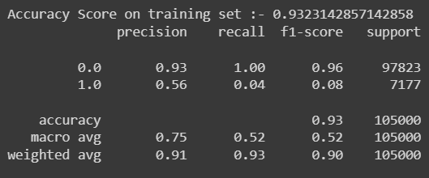
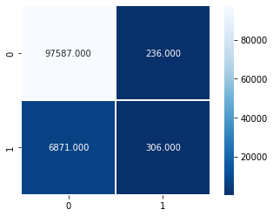
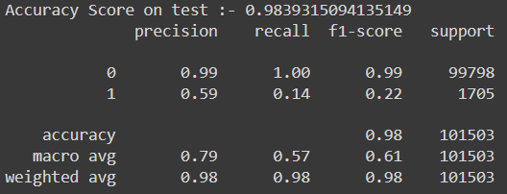
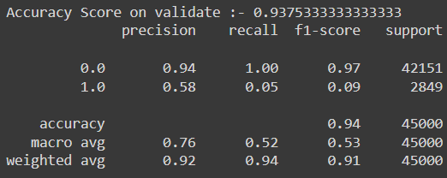

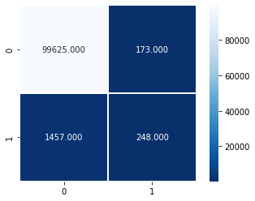
LOGISTIC REGRESSION
TRAINING DATA
TESTING DATA
VALIDATION DATA

Slide 12
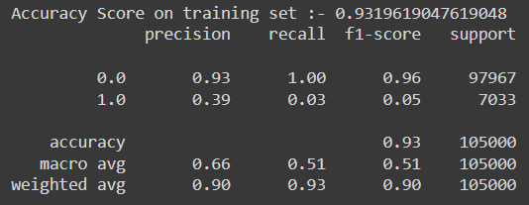
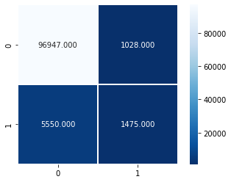
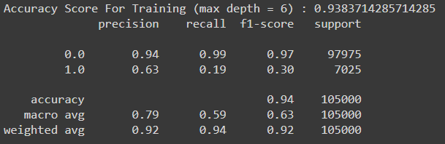
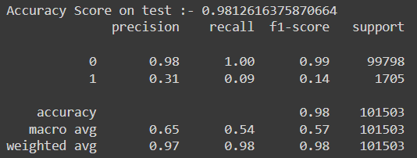
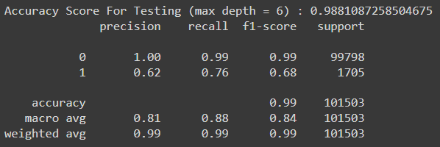

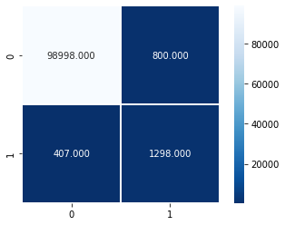
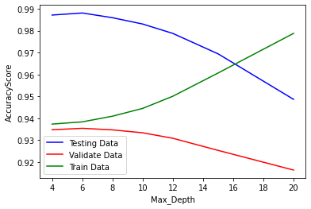
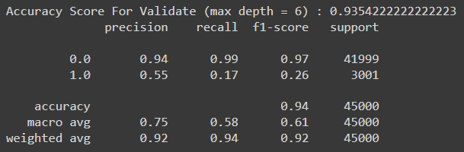
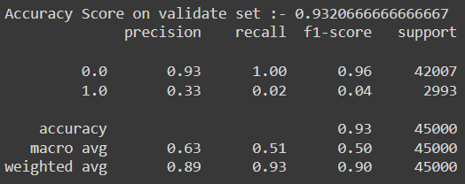
DECISION TREE CLASSIFIER-(GINI)
TRAINING DATA
TESTING DATA
VALIDATION DATA

Slide 13
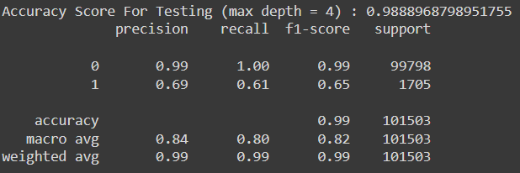
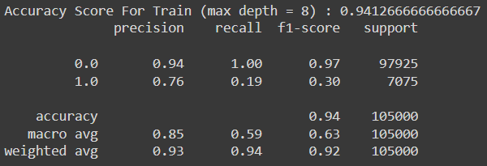

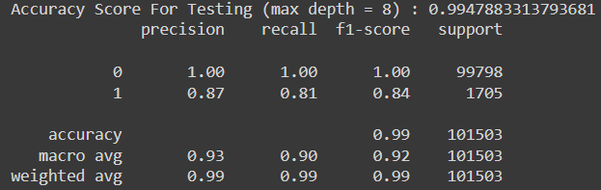
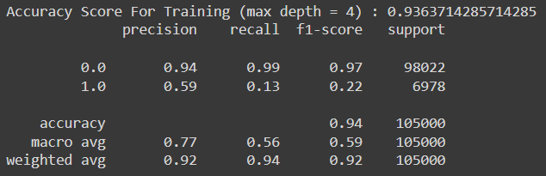


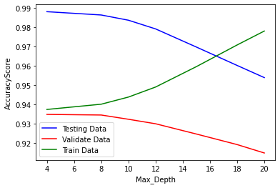
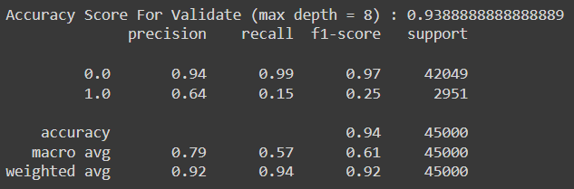
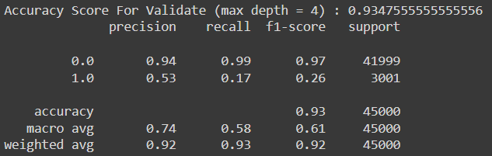
DECISION TREE CLASSIFIER-(ENTROPY)
TRAINING DATA
TESTING DATA
VALIDATION DATA

Slide 14


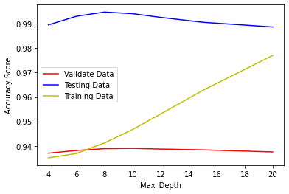

RANDOM FOREST
TRAINING DATA
TESTING DATA
VALIDATION DATA

Slide 15



NAIVE BAYES CLASSIFIER
TRAINING DATA
TESTING DATA
VALIDATION DATA

Slide 16
RESULTS
Model Type | Training Accuracy | Validation Accuracy | Testing Accuracy
LR | 93.23 | 93.75 | 98.39
NB | 93.19 | 93.20 | 98.12
DT (criterion = gini) | 93.83 | 93.50 | 98.81
DT (criterion = entropy) | 93.63 | 93.47 | 98.88
RF | 94.12 | 93.88 | 99.47

Slide 17
Conclusion
We conclude that on the given data we have Random Forest as the best model till now and this was also supported by the [2] research paper from literature survey section in which they recommend the random forest model as a good model for this analysis.

Slide 18
Timeline
Week 1-2: Data Collection (including Scraping)
Week 3: Pre-processing and Data Visualization.
Week 4: Feature Extraction.
Week 5: Feature Analysis, Selection, Correlation, HeatMaps.
Week 6: Logistic Regression, Naive Bayes
Week 7: Decision Trees, Random Forest.
Week 8: Analysis and performance of models and Report Writing
Future work
Week 9: SVM, MLP, NN and other algorithms , Dimensionality reduction with PCA, TSNE, cross validation
Week 10: Effect of Dimensionality Reduction, Hyperparameter Tuning, Check for model Overfitting and Underfitting.
Week 11: Report Writing.
Week 12: Buffer

Slide 19
Individual Contribution
Tasks | Team Members
Data Collection | Ashwin and Harsh
Pre-Processing and Data Visualization | Harsh and Shivam
Feature Extraction | Shivam and Sourav
Analysis of Features (EDA etc.) | Ashwin and Sourav
Logistic Regression | Ashwin and Shivam
Naive Bayes | Ashwin and Sourav
Decision Tree | Harsh and Shivam
Random Forest | Harsh and Sourav
Analysis and Performance of Models | Ashwin, Harsh, Shivam, and Sourav
Presentation and Report creation | Ashwin, Harsh, Shivam, and Sourav

Slide 20
References
[1] https://www.researchgate.net/publication/328559774_Automated_Credit_Scoring_System_for_Financial_Services_in_Developing_Countries
[2]
http://www.iaeng.org/IJCS/issues_v48/issue_3/IJCS_48_3_41.pdf
[3]
https://www.kaggle.com/competitions/GiveMeSomeCredit/data

